Slide 1
Agile Presentation
Jackson Foster

Slide 2
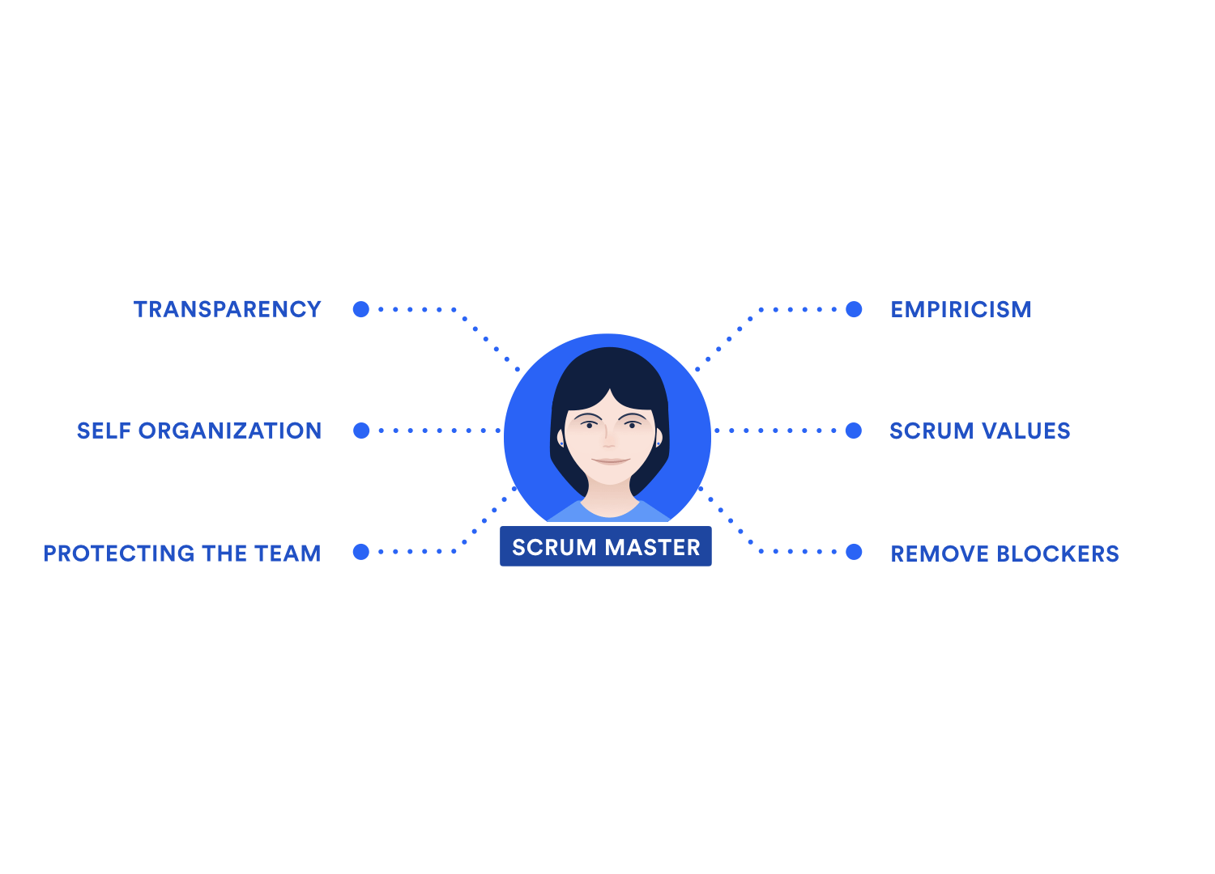
Scrum Master
Help product owner define value, development team deliver the value
They serve the product owner by helping them understand and communicate value, manage backlog, and help break down work to deliver effective learning
They serve the development team by ensuring that work is happening and that impediments are being removed
They serve the product owner by sprint planning, sprint review, and refining the product backlog
They are also the main role that gets everyone to start to communicate and be comfortable being outside their comfort zone

Slide 3
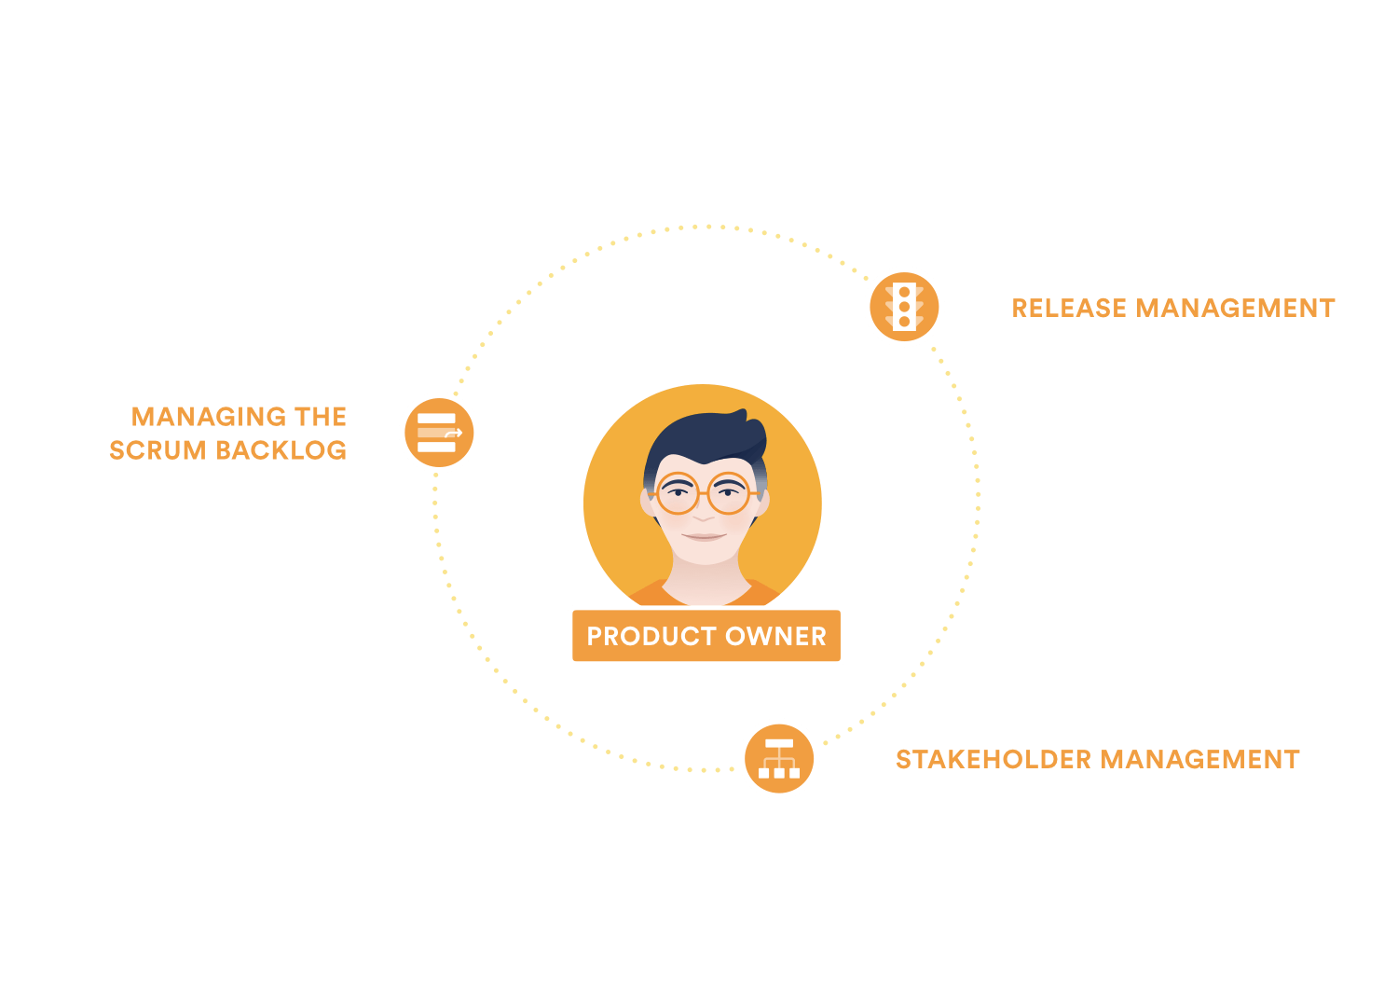
Product Owner
The product owner sets a clear direction for the product
They are responsible with communicating with clients and understanding what value needs to be added to the product
They also balance the needs of the stakeholders in the organization
They are responsible with setting the priority of the tasks to be able to adapt to new value added by the clients
Their main job is to create the most effective team by giving clear instruction and understanding of the product vision

Slide 4
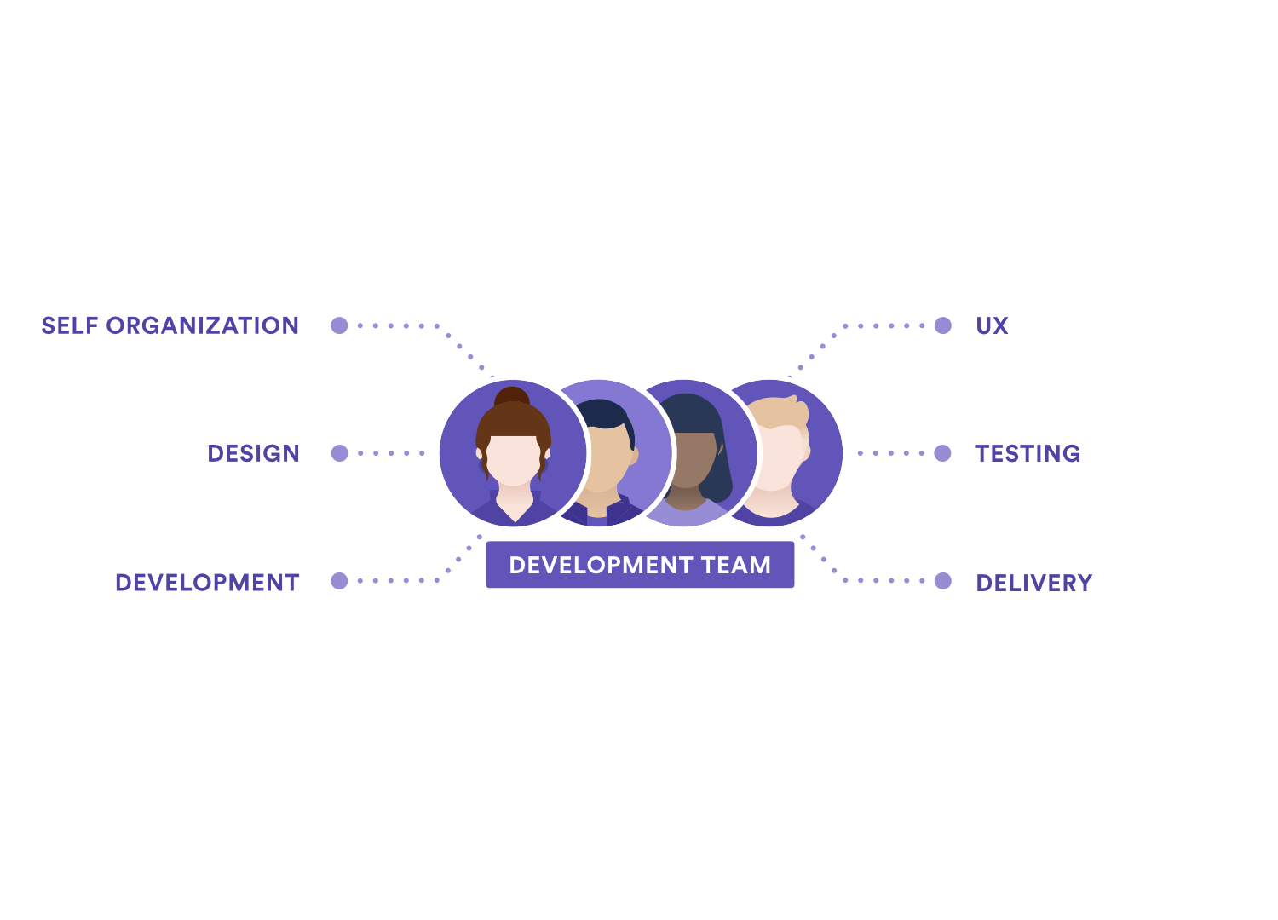
Development
The development team delivers work through the sprints
They are self organizing by giving them the ability to do what is needed to solve any problems that may arise
They need to ensure transparency during the daily scrum meeting by voicing what they are working on and what is stopping them
They are also responsible for product testing and making sure they can catch errors as they come up to increase efficiency
They are also responsible for on time delivery of the product

Slide 5
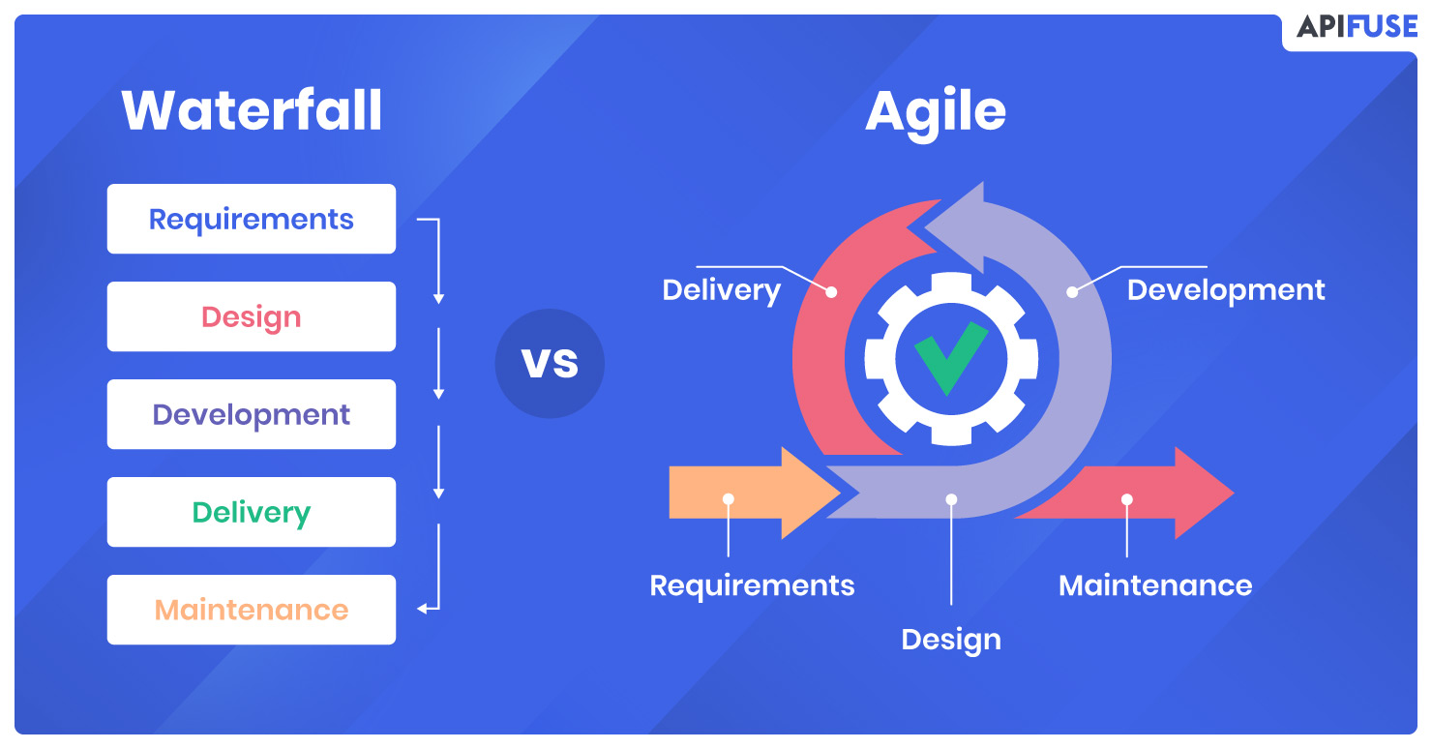
SDLC phases in Agile
Concept
Product owner determines scope of the project
Discuss key requirements with clients
Estimate time and cost
Inception
Build the development team by picking correct people for the job
Team will create a mockup of the interface and project architecture
Speak with stakeholders to fully flesh out all requirements
Iteration
Longest phase where developers work with UX designers to get all requirements met
Goal is the build basic functionality of the product
This stage is imperative to be able to add on to foundation that was created in this stage
Release
Testing is performed during this phase for quality assurance
Developers will fix bugs if any were found
Maintenance
This stage the software has been delivered and is fully accessible
This is where devops come in to fix any bugs that may come up
Retirement
This is the last stage where the product is either being replaced or is obsolete
This is where the users are notified and the developers shut down the product

Slide 6
Agile vs Waterfall
Agile Waterfall
High flexibility with product change | Low flexibility with product change
Requires Team initiative and short term deadlines to be efficient with product creation | Requires completing each stage before moving to the next stage
Hands on approach with frequent stakeholder interaction and input to create the product they are wanting | Hands off approach from Owner and goals and outcomes established from beginning

Slide 7
This Product with Waterfall
Pros | Cons
There would be a concrete plan for the product | Process can take longer with having to finish each stage before moving on
Establish product requirements early on which can save time | Less input from clients and stakeholders leading to a product that may not fit the exact vision that the client has
More structured workflow with having to deliver to progress to the next phase | Changing the product would have set back the development team by a lot to replan the new product vision

Slide 8
References
Agile vs. waterfall methodology: Making A choice. API Fuse. (2021, March 24). Retrieved December 11, 2022, from https://apifuse.io/blog/agile-vs-waterfall-methodology/
The Agile Software Development Life Cycle: Wrike Agile Guide. Wrike. (n.d.). Retrieved December 11, 2022, from https://www.wrike.com/agile-guide/agile-development-life-cycle/
West, D. (n.d.). Agile Scrum roles. Atlassian. Retrieved December 11, 2022, from https://www.atlassian.com/agile/scrum/roles

